Slide 1
Capstone Project - AI for Leaders
(Milestone2)
March 10, 2020
Telecom PhishAlert
Created by
Upasna Kaul
Krishnan Ramanujam
Gaurav Chhonker

Slide 2
Teams-Roles and Responsibilities
Data Engineering /Development Team (1 Engineer and 1 App Developer) | Data Scientist(1) | Product Manager(1) | Program Manager(1)
Identify Relevant Data – internal, External. App architecture | Model Building, Visualization and validation. | Feasibility and Value study | Creating and managing long-term goals.
Ingest Data to Data Lake | Model Deployment | How to integrate and improve AI model with changing business requirements and scope | Developing a budget and operating plan for the program.
Setup a data platform like a Warehouse or a Data Mart
Maintain the Data systems with scheduled data refreshes and Data augmentations.
We will require an SME with expertise in Fraud/Phishing Detection in BFSI Domain. We will try to hire someone for a short period of time.

Slide 3

Data Availability and Data Storage
Data Availability initially would be a challenge.
Data Availability
We would start by Collecting:
Descriptions of Telecommunication Fraud from the Internet.
Web Crawl used to collect data on spam numbers and VoIP numbers.
Collect the description language of Telecom fraud.
Scan web pages for news related to Telecom fraud.
TrueCaller API-Truecaller’s API allows for reverse number lookup, meaning developers can attach a name to a known number. It also returns a ‘Spam Score’ to indicate if a number is a likely spammer (e.g. telesales or robocalls) and — at the other end of the spectrum — a ‘True score’ to indicate how important the number is. This score is “the measurement of how popular a phone number is with our users over time”.
Data Storage:
Data will be stored in cloud initially. Azure or AWS data lakes will be leveraged.

Slide 4

Product Development Plan 6 Months to Go Live
Phase 1
Collection and Data Pre-processing
1. Descriptions of telecommunication fraud from the Internet.
2. Web Crawl used to collect data on spam numbers and VoIP numbers
3. Collect the description language of Telecom fraud.
4. Scan web pages for new related to Telecom fraud.
Phase 2
Extraction of attributes from data and Algorithms
1. Use Natural Language Processing (NLP) technology to extract attributes and keywords from call texts and databases.
2. Use speech to text conversion, TF-IDF Algorithm to identify the keywords
3. Use Classification Algorithms to classify the call as spam or non spam.
Phase 3
Implementation
1. Creation of an App which monitors the incoming call (and SMS as part of Expansion Plan) and identifies the one listed as spam.
2. Start recording the contents and use speech to text conversion to create text and run algorithm on that to find the phishing keywords.
3. Alert the user if certain keywords are found in the contents by constant beeps which are 15 seconds apart.

Slide 5
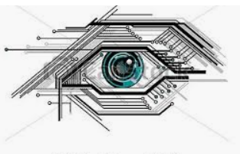

Metrics in Focus
Delivery Specific Metrics
Time/Schedule to deliver the product.
Cost to deliver the Product.
Scope of Work
Quality of Deliverable.
Regulations and Compliance necessary for Audits.
Product(Technical) Metrics
Precision - the fraction of calls that are correctly classified as phished vs which are actually phished.
Recall -Fraction of phished calls which are classified are phished from the dataset.
F-measure: harmonic mean of precision and recall
True Positive Rate: The percentage of phishing calls in the dataset that are correctly classified as phished.

Slide 6
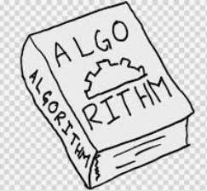
Techniques/algorithms helpful to build the product
Natural Language Processing (NLP)
Speech to text Conversion
Classification Algorithms
TF-IDF algorithm we will extract the keywords from the call

Slide 7
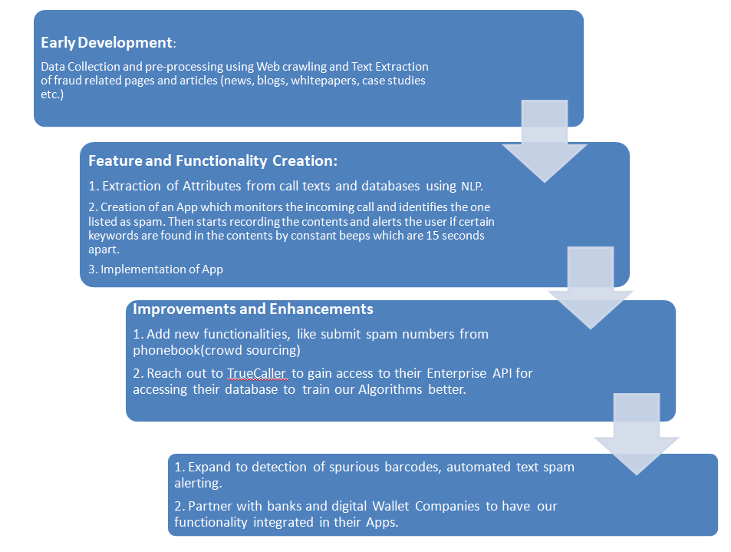

Product Development Roadmap

Slide 8

Expansion and Improvement Plan
The product will get better as we get more data included in the database.
Apart from the data collected through web crawling and publicly available databases, we would also augment the database by crowd sourcing (the data which people consent to share).
We will reach out to TrueCaller to gain access to their Enterprise API which they have started opening up to startups.
After gaining a significant customer base, we will look at the opportunity to collaborate with various banks and even the companies which have their own Digital Wallets. e.g. Paytm, Amazon Pay etc. for in App integrations.
Initially, the product(the mobile application) will focus more on the spam phone calls to alert the users of a possible phishing attempt.
Later, we would add the text spam detection along with spurious bar code scanning detection which are increasingly becoming more mainstream phishing phenomena.

Slide 9

Business Plan(Financials)
Costing | Year1 | Year2
Hardware cost
Android Handset | $500
I phone | $1,100
7 Laptops | $4,900
Software Cost
Concept Development Cost | $85,000 | $85,000 | 2 Data Engineers/Developers cost at $20 per hour
Simulator Software(Android+iOS) | $1650 | $1650 | License Cost for simulator per year
Operation and Hosting | $54,000 |  | Cost of hosting and creating a basic app(estimatemyapp.com)
API Cost-TrueCaller | $900 |  | Paid API for 2 months
Support | $17,000 | $17,000 | 20% of Concept Development Cost
Managemnet Cost | $130,000 | $130,000 | 1 Data Scientist and 1 Product Manager@ $30 per hour
Training and Support
Implementation cost |  |  | This will be a sum of concept development and Operation and hosting
Marketing Cost | $3,600 | $3,600 | $10 per day budget-Automatic-Link Click(CPC-cost per click)
Misc Costs | $20,000 | $20,000 | For the first year, will cover SME cost, if hired for a short time
Contingencies | $60,000 | $50,000
Total | $378,650 | $307,250

Slide 10

Revenue Models and Metrics
We will initially start with Freenomics model and give the app for free for around 6 months.
After we have a user base of around 10000 we will start putting in the Ads and partner with Google Adsense, both banner and interstitial ads.
We will have an agreement of $0.01 click per view(standard market rate) and will ask the user to click an advertisement for every spam number they want to report.
10,000 daily users on will make it 100$ every day.
We are looking to have a user base of around 100,000 the end of first year. Assuming we will have one click per user in a day. 100000*0.01*30*12 =$360,000 will be our initial yearly revenue.
User Metrics
Daily Active User (DAU)-the number of active users per day.
Monthly Active User (MAU) – the number of active users who complete valuable activities per month.
Customer Lifetime Value -average profit from one user before they cancel a subscription
Customer Acquisition Cost-This metric covers all the costs spent on attracting customers: marketing spending, sales team work, advertising.
Customer Retention Rate- how long we’ll be able to retain new customers and if customer retention rate is growing/dropping.
Net Promoter Score (NPS):This metric measures the number of loyal customers who are likely to recommend a product
*According to the above calculations we should be able to break even after 18 months of launch.*

Slide 11


